Slide 1
AVL Trees
Presentation for use with the textbook Algorithm Design and Applications, by M. T. Goodrich and R. Tamassia, Wiley, 2015
6
v
3
8
z
4

Slide 2
AVL Tree Definition
AVL trees are rank-balanced trees.
The rank, r(v), of each node, v, is its height.
Rank-balance rule: An AVL Tree is a binary search tree such that for every internal node v of T, the heights (ranks) of the children of v can differ by at most 1.
An example of an AVL tree where the ranks are shown next to the nodes

Slide 3
Height of an AVL Tree
n(2)
3
4
n(1)
Fact: The height of an AVL tree storing n keys is O(log n).
Proof (by induction): Let us bound n(h): the minimum number of internal nodes of an AVL tree of height h.
We easily see that n(1) = 1 and n(2) = 2
For n > 2, an AVL tree of height h contains the root node, one AVL subtree of height n-1 and another of height n-2.
That is, n(h) = 1 + n(h-1) + n(h-2)
Knowing n(h-1) > n(h-2), we get n(h) > 2n(h-2). So
n(h) > 2n(h-2), n(h) > 4n(h-4), n(h) > 8n(n-6), … (by induction),
n(h) > 2^{i}n(h-2i)
Solving the base case we get: n(h) > 2 ^{h/2-1}
Taking logarithms: h < 2log n(h) +2
Thus the height of an AVL tree is O(log n)

Slide 4
Insertion
Insertion is as in a binary search tree
Always done by expanding an external node.
Example:
44
44
17
78
17
78
c=z
a=y
32
50
88
32
50
88
48
62
48
62
b=x
54
before insertion
w
after insertion

Slide 5
Trinode Restructuring
Let (a,b,c) be the inorder listing of x, y, z
Perform the rotations needed to make b the topmost node of the three
Single rotation around b
Double rotation around c and a
a=z
a=z
b=y
T₀
c=y
T₀
c=x
b=x
T₃
T₁
b=y
b=x
T₂
T₃
T₁
T₂
a=z
c=x
a=z
c=y
T₀
T₁
T₂
T₃
T₀
T₁
T₂
T₃

Slide 6
Insertion Example, continued
unbalanced...
T
4
1
44
2
3
x
17
y
62
z
1
2
2
32
50
78
1
1
1
...balanced
48
54
88
T
2
T
T
T
0
1
3

Slide 7
Restructuring (as Single Rotations)
Single Rotations:

Slide 8
Restructuring (as Double Rotations)
double rotations:

Slide 9
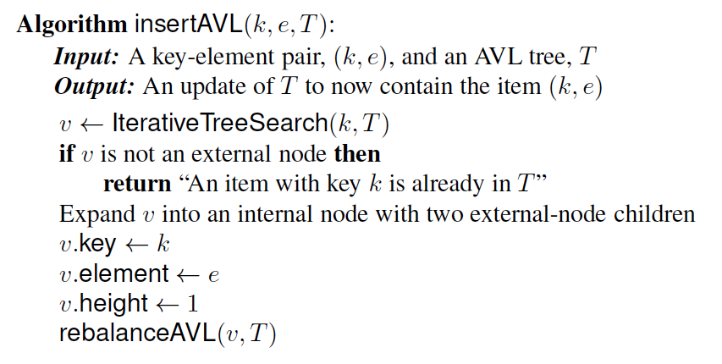
Pseudo-code
Insertion.

Slide 10
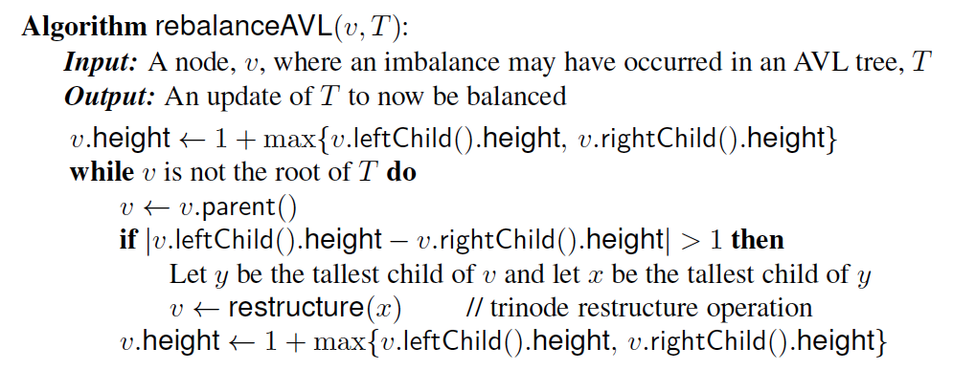
Pseudo-code
Rebalance at a node violating the rank rule.

Slide 11
Removal
Removal begins as in a binary search tree, which means the node removed will become an empty external node. Its parent, w, may cause an imbalance.
Example:
44
44
17
62
17
62
32
50
78
50
78
48
54
88
48
54
88
before deletion of 32
after deletion

Slide 12
Rebalancing after a Removal
Let z be the first unbalanced node encountered while travelling up the tree from w. Also, let y be the child of z with the larger height, and let x be the child of y with the larger height
We perform a trinode restructuring to restore balance at z
As this restructuring may upset the balance of another node higher in the tree, we must continue checking for balance until the root of T is reached
a=z
62
44
w
b=y
44
78
17
62
c=x
17
50
88
50
78
48
54
48
54
88

Slide 13
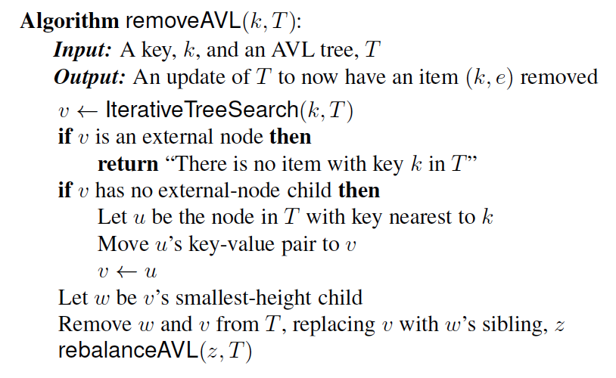
Pseudo-code
Removal

Slide 14
AVL Tree Performance
AVL tree storing n items
The data structure uses O(n) space
A single restructuring takes O(1) time
using a linked-structure binary tree
Searching takes O(log n) time
height of tree is O(log n), no restructures needed
Insertion takes O(log n) time
initial find is O(log n)
restructuring up the tree, maintaining heights is O(log n)
Removal takes O(log n) time
initial find is O(log n)
restructuring up the tree, maintaining heights is O(log n)

